Slide 1
Portrait of the Whole Person:
Disability History and Culture
Created by Stacie Siebrecht, Associate Director of Legal Advocacy at Disability Rights Washington

Slide 2
Words Matter!
Words can change the way we see someone.
Words give or take away respect.

Slide 3
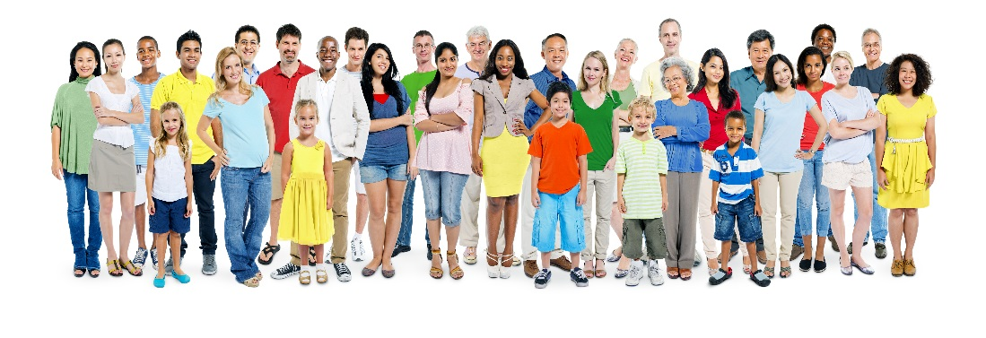
What do you call a person with a disability?
A Person
What makes you different? Hair color, height, athleticism, humor. Do you want to only be known as the girl with brown hair?

Slide 4
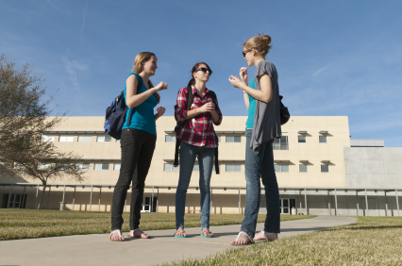
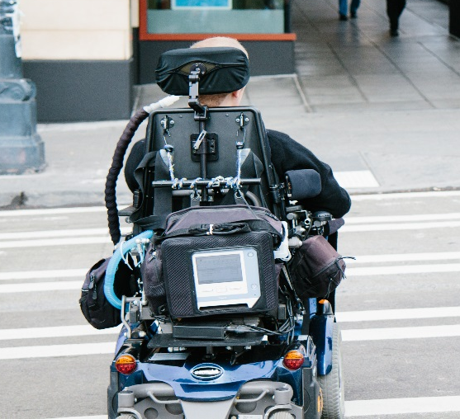
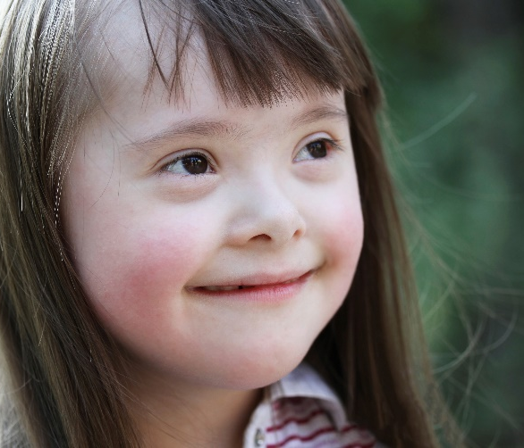
What kinds of words should you use when talking about a person’s disability?
Treat them as a person first.

Slide 5
What can I say?
Ask the person what they prefer if you can. Person-first or Identity-First?
Say: Person First:
Person with a disability
They have a mental illness
They have low vision
Identity-First:
Deaf individual
They are disabled
They are Autistic
Don’t Say:
Wheelchair bound
The R Word
Differently-abled
Special Needs
Notes:
Teacher Tip: Let people with disabilities identify themselves in their own way. Do not correct them. Recognize that what is acceptable to the general disability community is not necessarily the case for all subgroups or individuals (e.g., deaf, blind, autism).

Slide 6
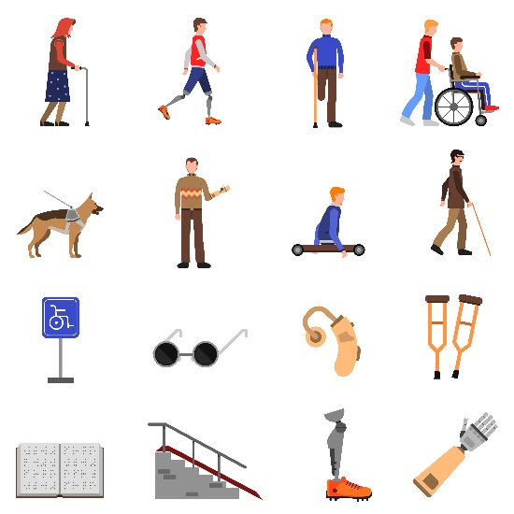
What types of disabilities exist?
Disabilities may affect a person’s:
ability to move, see, speak, hear, think, feel, act, or learn
When can a person get a disability?
A person may be born with a disability.
Some people are born with a condition, but it does not show up until later in life
Some people acquire disabilities later in life.

Slide 7

How many people have disabilities?
Statistics Vary
Between 14% and 20% of all the people in the world have a disability

Slide 8
How do people think about disability? The Medical Model.
The way someone thinks about disability depends on who the person is and why they are asking:
A doctor thinks about identifying the condition and treating it.
A person wants to raise money and presents images of children with disabilities asking people to donate to cure these children.

Slide 9
Another way to think about disability: The Social Model.
Disability describes how society sees and treats a difference in the way a person’s mind or body works.
The parts of our community that are disabling include things like negative attitudes, inaccessible transportation and buildings, and a lack of social supports.

Slide 10
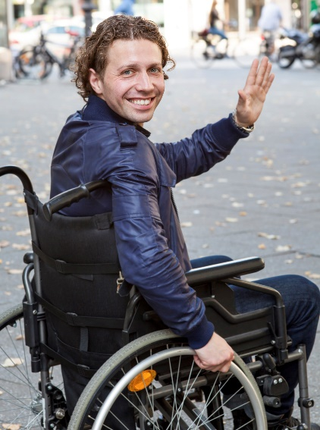
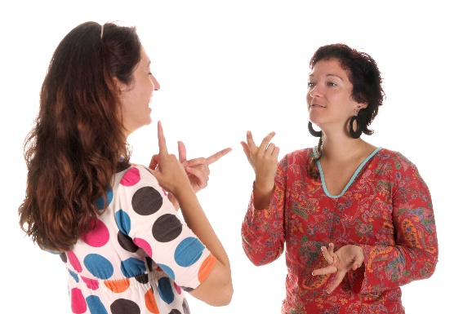
Here are some examples
Society: Many buildings have only stairs to access upper floors
Disability:
Solution:
Society: when a person cannot talk, other people assume the person cannot think or communicate
Disability:
Solution:
A person using a wheelchair cannot access much of the building
use ramps, elevators and lifts
Person who lacks speech is treated unfairly, ignored, and subject to discrimination
find ways to communicate, do not assume, and include

Slide 11
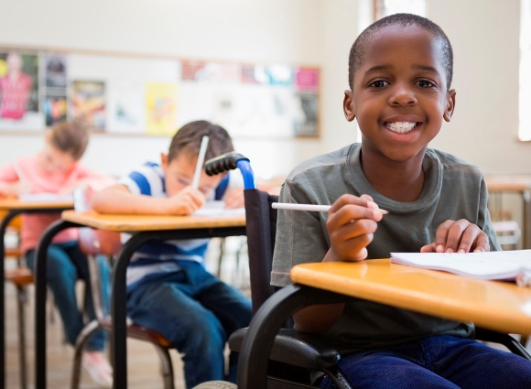
Social Perspective Asks: What Can You Do?
Look for ways to make the world accessible to people with disabilities
Treat people with disabilities with respect
Include people with disabilities
Make sure people with disabilities have equal civil rights
https://www.youtube.com/watch?v=wrNy_2ljVdo

Slide 12
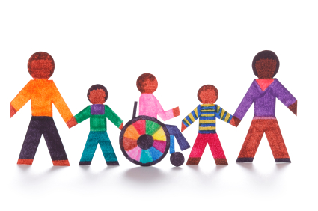
The Civil Rights Movement of People with Disabilities
The same rights as other citizens
Such things like the right to an education, to vote, to access public transportation, to access public spaces, to equal employment opportunities, and to live in the community

Slide 13
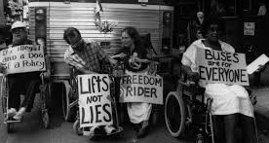
A long history of discrimination
Discrimination: the practice of unfairly treating a person or group of people differently from other people or groups of people .
People with disabilities have been abandoned, abused, pitied, segregated, neglected and isolated.
For centuries, different groups of people with disabilities fought for their rights such as the right to get jobs, be educated, be free from abuse and receive treatment.

Slide 14
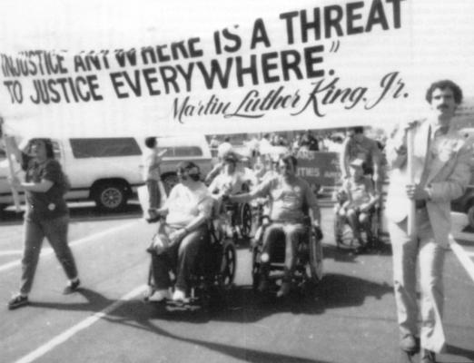
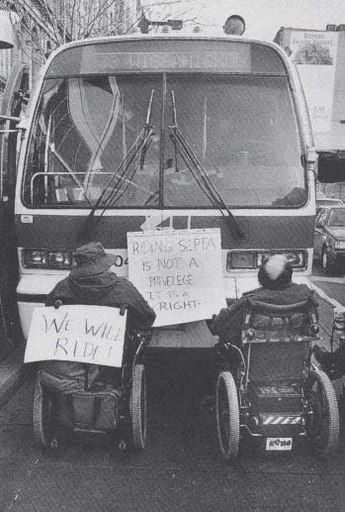
Slow Change: Compare the 1964 Civil Rights Act
1973
Rehabilitation Act section 504
Provides an equal opportunity for employment and prohibits discrimination for federal funded programs
1975
Individuals with Disabilities Education Act (IDEA)
Protects right to free and appropriate public education

Slide 15
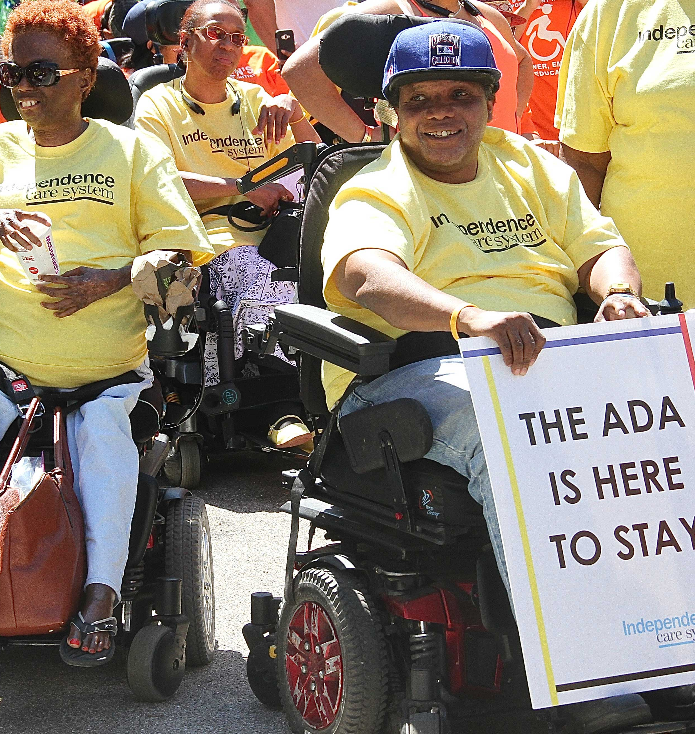
CIVIL RIGHTS FOR PEOPLE WITH DISABILITIES
1990
Americans with Disabilities Act
cross-disability coalition
protects equal opportunity to work, transportation, telecommunications, public spaces, and government services

Slide 16
What is the Portrait of the Whole Person Project?
You will learn about a person who is successful and who has a disability through research, writing, and art. Here are the five steps:
Select an individual who is successful who also has a disability.
Research the individual’s life.
Write a one-page description of the person.
Create a portrait of the person.
The class hosts a show for others to see the portraits and one-page descriptions.

Slide 17
Your Research Projects: Seeing the Whole Person
Consider how the disability impacted the individual:
Did it lead them to a new activity?
Did it help them see things differently?
Did it create a new passion for them?
Did it relate to their success at all?
Did they work harder to achieve success?
Consider how society can change to make the person’s condition less of a “disability” (perceptions, access, rights)
Edit your work and make sure to show respect instead of pity.

